Slide 1
Raspberry Pi Game Simulation
COSC 439 Project
Michael Santoro Cesar Suchite
Esmir Lugonjic Nick Hess

Slide 2
Introduction
“The Raspberry Pi is a series of credit card–sized single-board computers”...”with the intent to promote the teaching of basic computer science” (wikipedia)
Some of the features include:
Low cost: ~$35 for the model, or ~$100 for an entire “do it yourself” entire kit.
Size: Can fit almost anywhere, including game controllers, custom lego sets, even GameBoys.
Has numerous I/O slots, including USB, monitor, audio, and keyboard.
Programmed in various languages, most notably C.
Suitable for all ages as the installation is simple and you don’t have to worry about breaking an expensive piece of hardware.

Slide 3
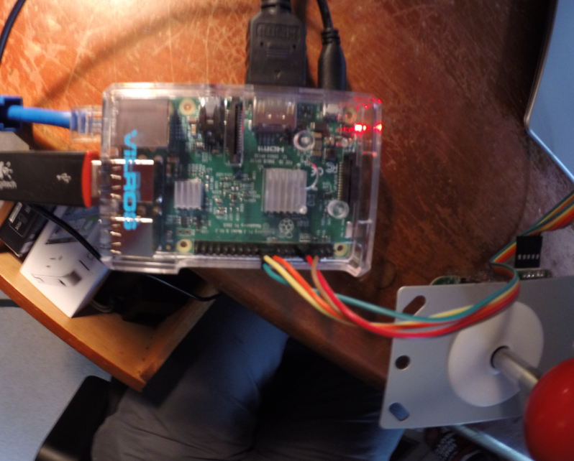
Our Raspberry Pi Model
There are several generations of Raspberry Pi models. The one we are using is Raspberry Pi 3 Model B:
1GB RAM
Broadcom BCM2837 64bit ARMv8 Quad Core Processor powered
SingleBoard Computer running at 1.2GHz
BCM43143 WiFi

Slide 4
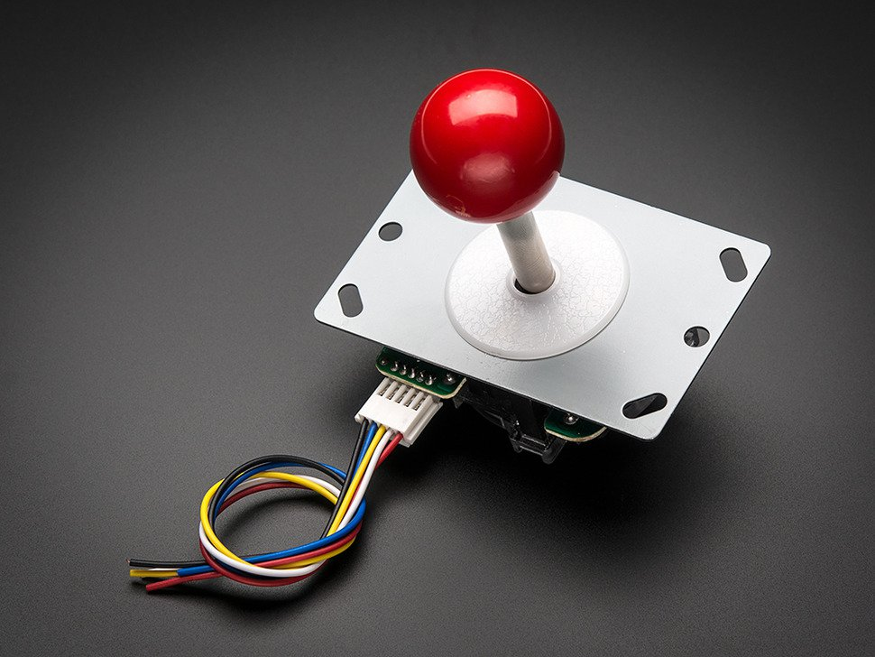
Our Game Simulation (Installation)
Our project focuses on arcade game simulation within the Raspberry Pi operating system (raspbian).
We used the following materials:
Raspberry Pi 3 Model B (including basic components such as power cable)
16 GB SD card
Small arcade joystick
USB Mouse and Keyboard (for testing purposes).

Slide 5
Our Game Simulation (Installation...cont...)
We installed and extensively modified an emulator known as MAME4ALL (source code provided in submission).
After modification, installation was easy:
sudo mkdir -p /usr/local/bin/indiecity/InstalledApps/mame4all_pi/Full
sudo mv mame4all_pi.zip /usr/local/bin/indiecity/InstalledApps/mame4all_pi/Full
cd /usr/local/bin/indiecity/InstalledApps/mame4all_pi/Full
sudo unzip mame4all_pi.zip
sudo ./install.sh

Slide 6
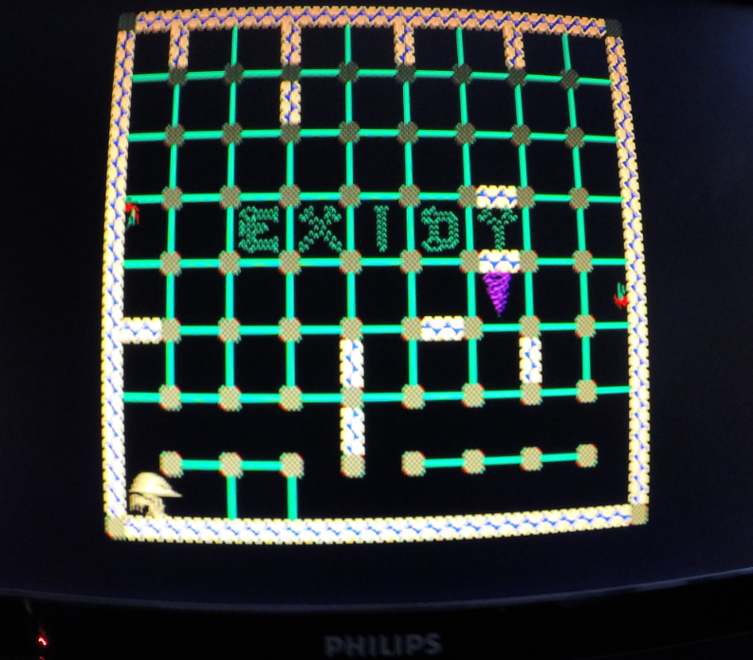
Our Game Simulation (Game)
AdaFruit is a retro game available as a free download as is commonly used to test arcade emulation on the Raspberry pi.
Link to GitHub: https://github.com/adafruit/Adafruit-Retrogame

Slide 7

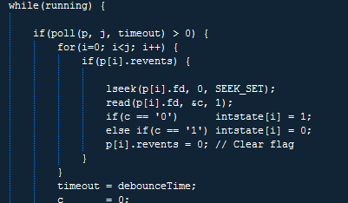
Source Code
driver written in C
based off of a interrupt driven GPIO driver

Slide 8
DEMO
https://www.youtube.com/watch?v=3ap5blo7yvQ&feature=youtu.be

